Slide 1
Introduction to Respiration

Slide 2
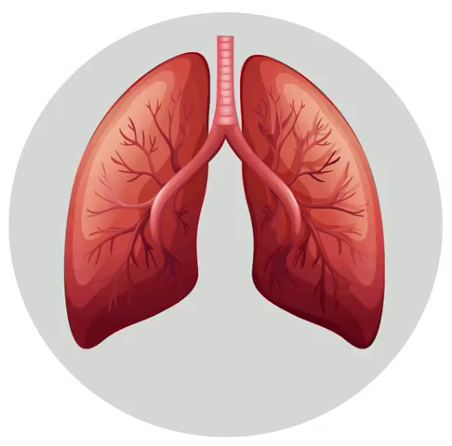
By the end of this lesson you should be able to:
1. | State the overall function of the respiratory system.
2. | Explain the difference between respiration and breathing.
3. | Describe where each structure of the respiratory system is located and its function.

Slide 3
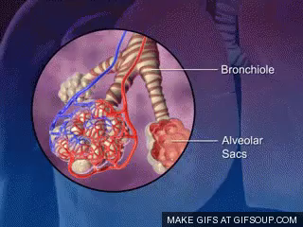
Now ask yourself, why do we need to breathe?
If we stop breathing we will die, but why exactly is that?
Throughout this topic, you will learn why we must "breathe or die" and how deceptively complex the whole breathing process really is.

Slide 4
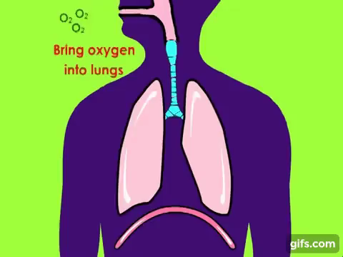
The respiratory system allows us to take in oxygen and remove carbon dioxide.
This is essential, as all cells need oxygen in order to function. As a by-product of cellular processes, cells produce carbon dioxide, which must be removed or else it becomes toxic within the body.

Slide 5
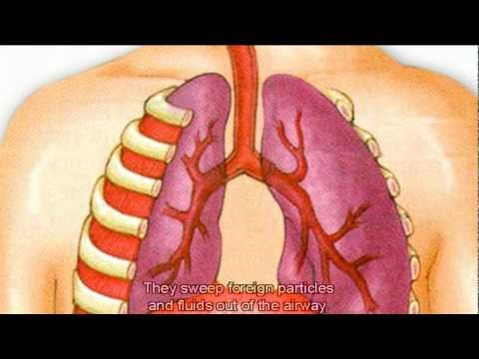

Slide 6
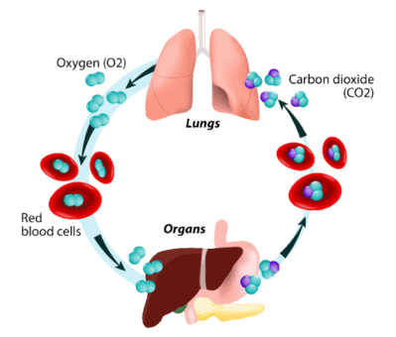
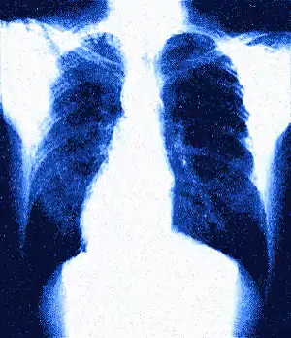
Respiration is a series of chemical reactions that cells perform in order to produce energy from nutrients (food).
Breathing is the physical act of moving air into and out of our bodies, by inflating and deflating our lungs.

Slide 7
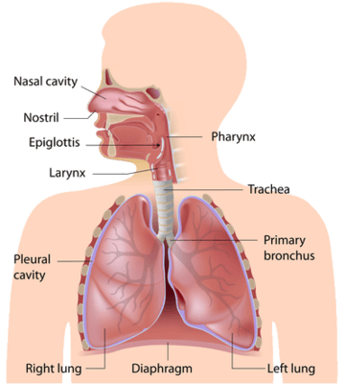
The diagram below outlines the main structures of the respiratory system.
It is important to be able to identify their structures and understand their functions.

Slide 8
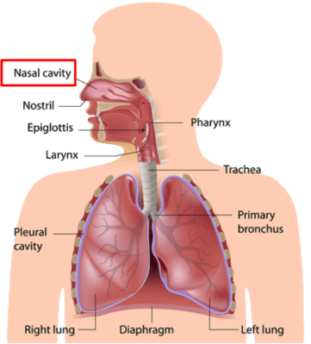
The nasal cavity or nose allows air to flow in.
Inside the nose, the air is filtered using fine hairs called cilia, removing any harmful particles. There is also sticky mucus produced by goblet cells, which trap particles.
Respiration is a series of chemical reactions that cells perform in order to produce energy from nutrients (food).

Slide 9
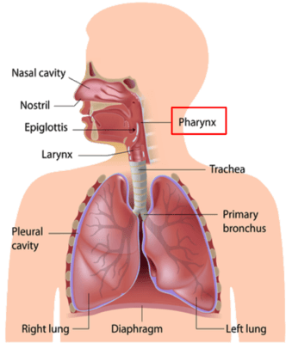
Air flows down from the nose to enter the pharynx.
This is the soft part at the top of the throat that connects the mouth and nose to the oesophagus (carries food to the stomach).

Slide 10
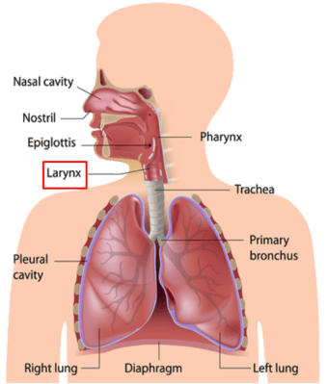
From the pharynx, air flows into the larynx.
These structures sound the same, so do not get them confused!
This is the hollow muscular organ forming an air passage to the lungs.
It contains our vocal cords, which we can vibrate as air passes them, allowing us to speak.

Slide 11
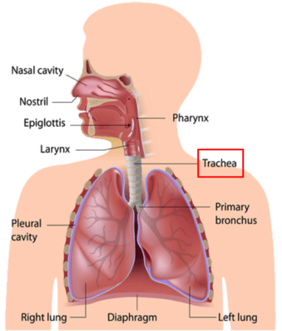
The trachea
The larynx flows in to the trachea or "windpipe".
The trachea is a tube that carries air to the lungs.
It is strengthened by rings made of cartilage, so that it doesn't collapse.

Slide 12
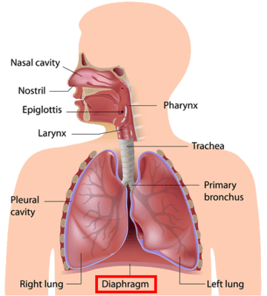
The main muscle that allows us to breathe is the diaphragm.
Contraction of the diaphragm muscle expands the lungs during inhalation when one is breathing air in.
It is found underneath the lungs.

Slide 13
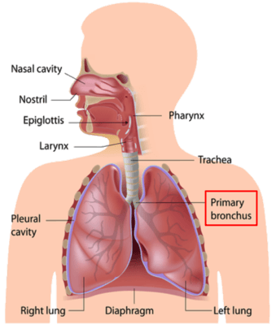
The bronchi
Right before the lungs, the trachea splits in two, forming two bronchi (singular="bronchus").
The bronchi go into a lung each.

Slide 14
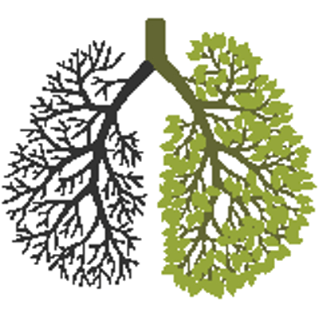
Within the lungs, the bronchi split into many smaller and smaller branches, known as bronchioles.
This can be thought of like an upside-down tree.

Slide 15
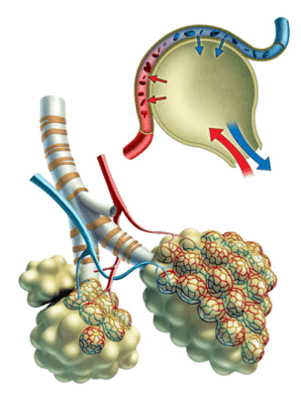
The alveoli
At the very end of each bronchiole are bunches of little air sacs (like bunches of grapes) called alveoli (singular= "alveolus").
The alveoli are the place where gas exchange occurs.

Slide 16
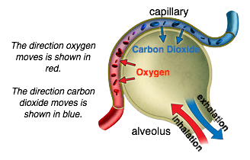
Gas exchange
Gas exchange is where oxygen that we have breathed in is moved into the bloodstream for cells to take up, and where carbon dioxide shifts from the bloodstream into the lungs, so that it can be breathed out.
Alveoli are very thin and moist, so that oxygen and carbon dioxide can quickly and easily move through them, into or out of the blood.

Slide 17
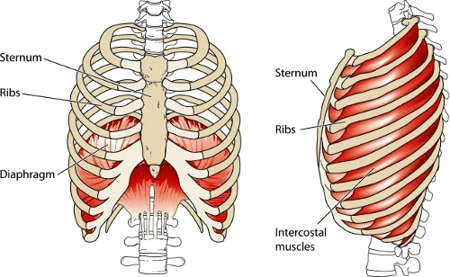
The ribcage protects the lungs and blood vessels.
It expands and contracts along with the lungs to allow for efficient breathing.

